Slide 1


CAR INSURANCE

Slide 2

CONTENT:
1
DATASET OVERVIEW
2
INSURANCE CAR OVERVIEW
3
INSURANCE CLIENT INFORMATION
4
CONCLUSION

Slide 3
1
DATASET OVERVIEW

Slide 4
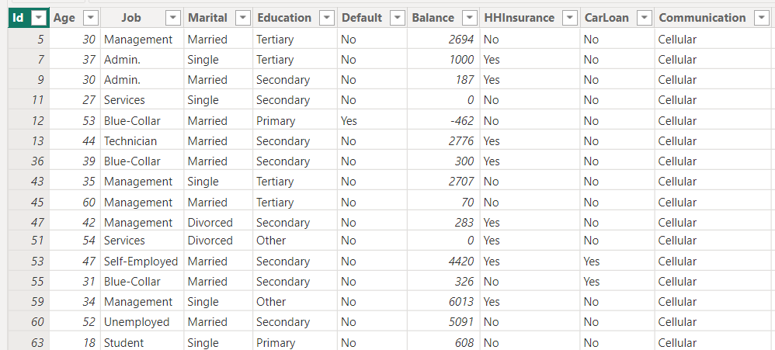
1
DATASET OVERVIEW

Slide 5
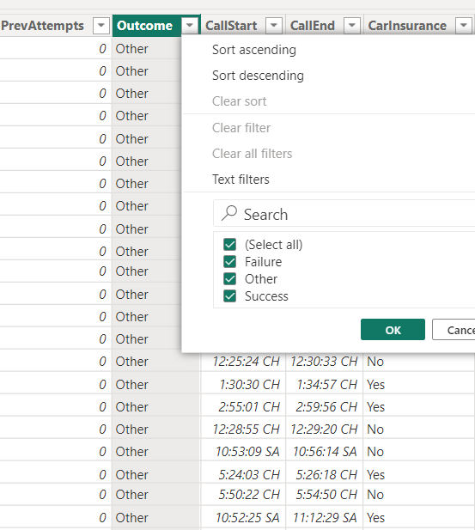
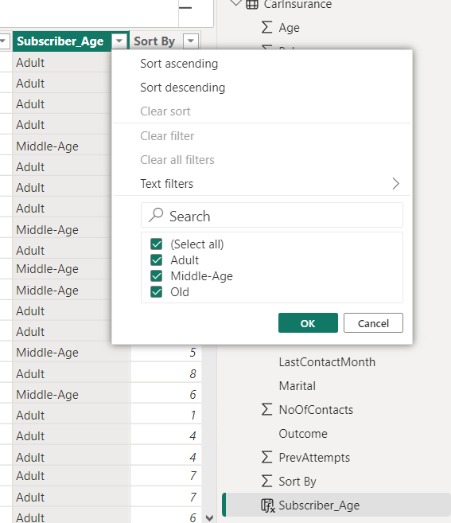
1
DATASET OVERVIEW

Slide 6
CONTENT:
1
DATASET OVERVIEW
2
INSURANCE CAR OVERVIEW
3
INSURANCE CLIENT INFORMATION
4
CONCLUSION

Slide 7
2
INSURANCE CAR OVERVIEW

Slide 8
2
INSURANCE CAR OVERVIEW
48,71
Average of DaysPassed
2,61
Average of NoOfContacts
2870
Total of PrevAttempts

Slide 9
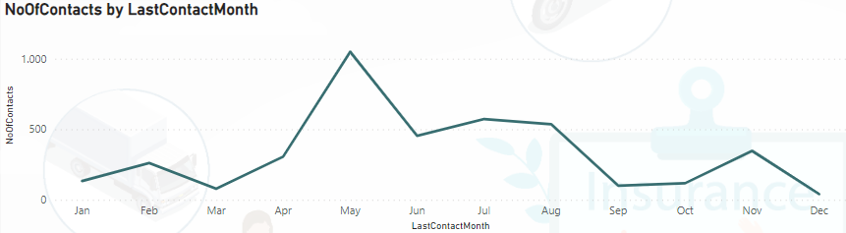
2
INSURANCE CAR OVERVIEW
The Number of Contacts over the months are uneven. The highest in May, the lowest in December

Slide 10
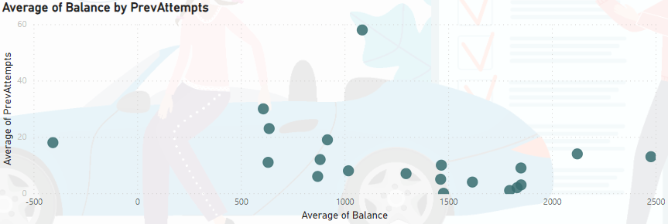
2
INSURANCE CAR OVERVIEW
Clients with high balances will pay attention to insurance more than Clients with low balances

Slide 11
CONTENT:
1
DATASET OVERVIEW
2
INSURANCE CAR OVERVIEW
3
INSURANCE CLIENT INFORMATION
4
CONCLUSION

Slide 12
3
INSURANCE CLIENT INFORMATION

Slide 13
3
INSURANCE CLIENT INFORMATION
4000
Clients
41,21
Average of Age
1,53K
Average of Balance

Slide 14
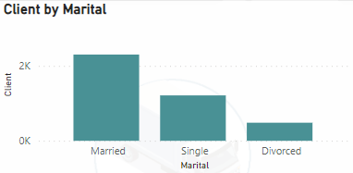
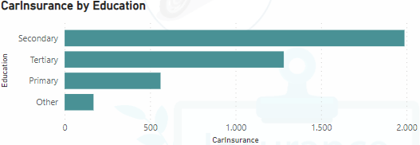
3
INSURANCE CLIENT INFORMATION
Married people may tend to focus on protecting family and assets, including purchasing car insurance to ensure safety while traveling.
Clients with higher levels of education may have a better understanding of driving risks and are therefore more likely to purchase car insurance.

Slide 15
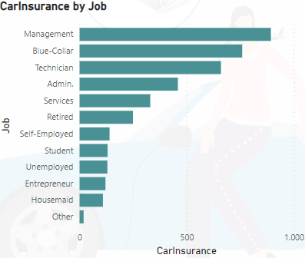
3
INSURANCE CLIENT INFORMATION
People with higher income from their job can easily afford car insurance => more likely to buy car insurance

Slide 16
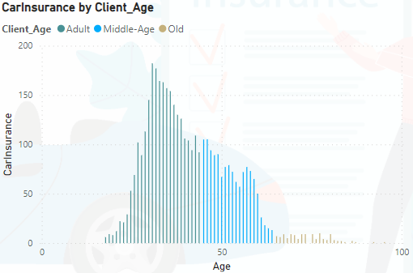
3
INSURANCE CLIENT INFORMATION
Age can reflect the level of risk when driving. In this case, Adult Clients may pay attention to car insurance more than Middle-Aged and Old Clients

Slide 17
CONTENT:
1
DATASET OVERVIEW
2
INSURANCE CAR OVERVIEW
3
INSURANCE CLIENT INFORMATION
4
CONCLUSION

Slide 18
4
CONCLUSION
Understanding the amount of effort required before achieving results can help optimize future marketing strategies.
The results of your outreach can indicate your customer's level of engagement. This can be an important indicator of customer interest and attitude towards the product or service.
A better understanding of the client information such as age, marital status, job and education level can help manage risk more effectively and identify client groups with higher risk.

Slide 19
Thanks for watching

